Slide 1


Predicting Road Accidents Severity
Dipika Sharma

Slide 2

Road Accidents
Any incident that happened on road and results in death or injury.
World Health Organization 1.19 M people dies due to road accidents.
The rate of unnatural death is increasing every year.
Notes:
According to World Health Organization 1.19 M people dies every year because of road accidents. This number not only include adult but kids and young adults of age between 5-29. Road accidents is one of the major causes of unnatural deaths. To our surprise the rate for unnatural death is increasing every year.

Slide 3

Goal
Predict Severity of the incidents
Performed analysis on different features to understand the relationship between the observed features with target feature.
Share the knowledge with government so that they can reduce fatalities by
Raising Awareness among public
Educating drivers about the traffic laws.
Introduce mandatory check on road surface.
Others.

Slide 4
Dataset: Source
Kaggle Dataset
Data from Addis Ababa Sub-city police departments.
The records of road accidents happened between 2017 to 2020

Slide 5
Dataset Features
Dataset is good for our purpose as it consists of target feature “Accident_ severity”.
The database has 12316 rows and 32 columns.

Slide 6

Data Understanding
Missing Values: The dataset have features with missing values, We’ll replace the missing values with ‘Unknown’ and ‘Others’
Used One-Hot encoding get dummies to improve accuracy.
This Photo by Unknown Author is licensed under CC BY-SA-NC

Slide 7

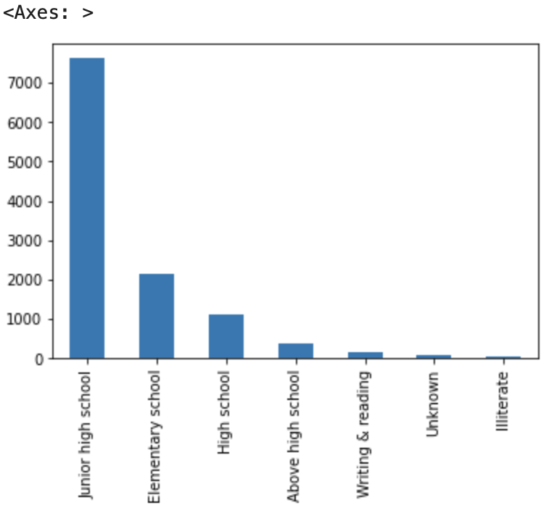
Driver’s Education Level
~8000 of the road accidents happened when drivers' education is till junior high school.
Lest than 500 accidents involved drivers with education level above high school.
Government can plan campaign to educate drivers about road sign and traffic laws
introduce mandatory programs to pass the driving license to make sure all drivers understand the road rules and laws.

Slide 8


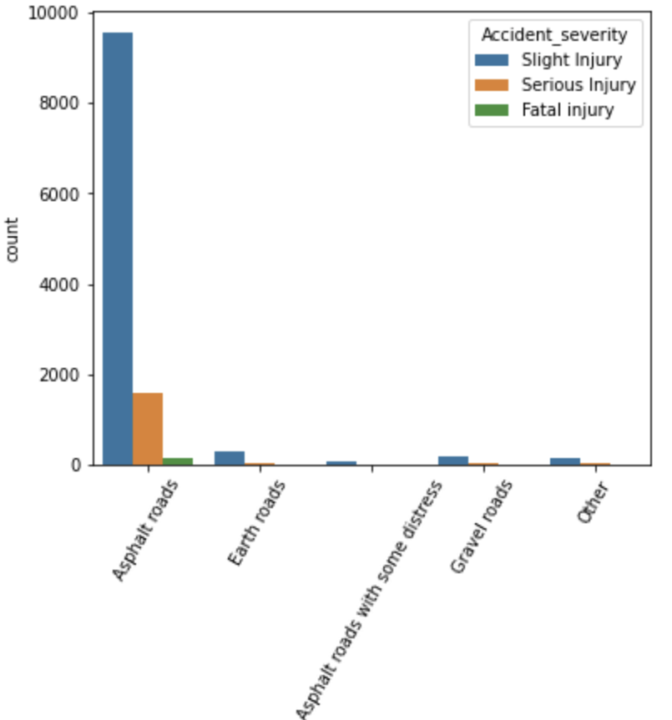
Road Surface Type
Asphalt road have most of the accidents.
Serious injury happened on Asphalt road
Government can perform some quality checks when they used the road surface as Asphalt

Slide 9
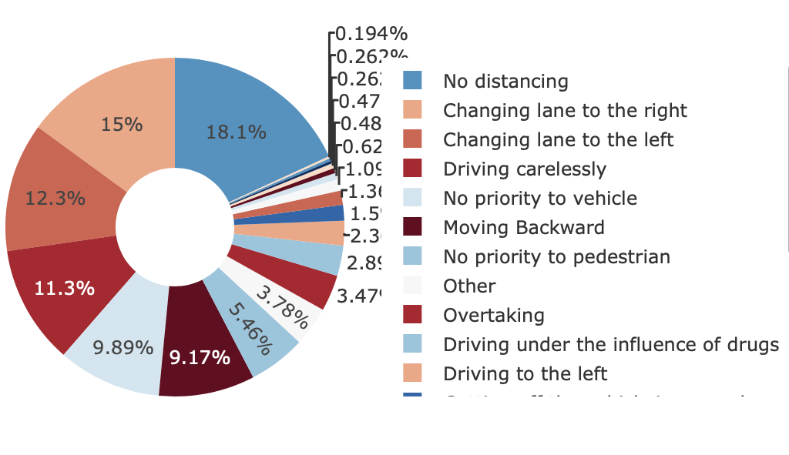
Accidents Cause
18% No distancing
15 % or 12.3 %when driver change lanes.
11.3 % drives carelessly.
Moving Backward.
Government can impose some strict rules to reduce the number of road accidents.

Slide 10
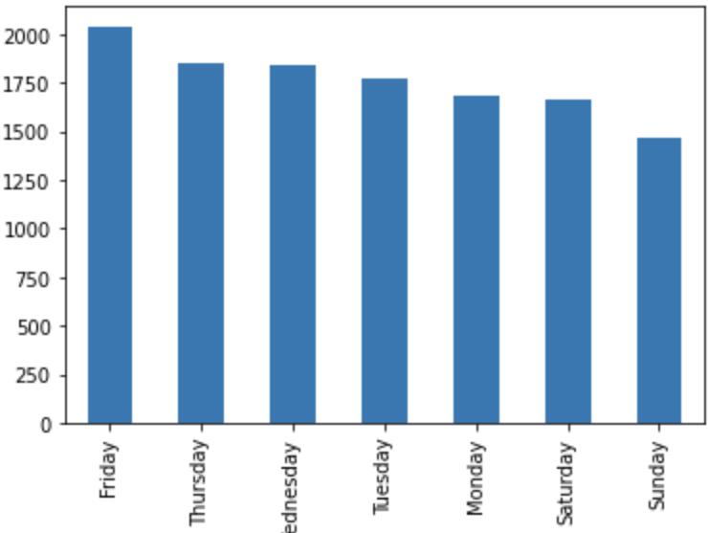
What day of the week do most accidents happen?
Friday has most of accidents
Saturday & Sunday have a smaller number of road accidents.
Weekdays have mor number accidents compared to weekends.
Rules are imposed to reduce the road accidents,

Slide 11
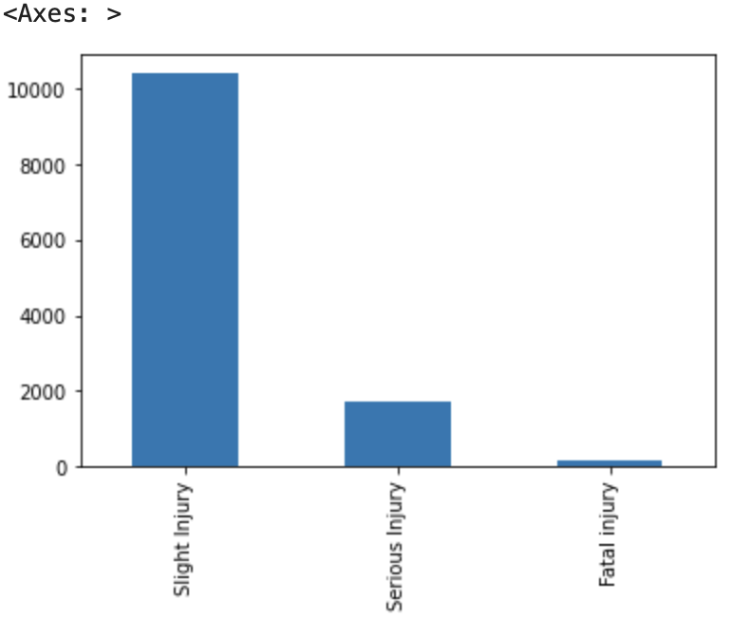
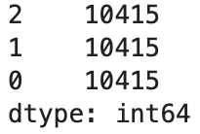
Target variable Distribution
Target variable is imbalanced
Performed SMOTE to balanced the severity feature.
Result after performing SMOTE.
Notes:
Most of the accidents involve slight injury compared to serious or fatal injury. The above outcome showing that the data is imbalanced.
As we can clearly see that the observation outcome of the dataset is unevenly distributed as the slight injuries is almost 5 times more than with accidents involves serious or fatal injuries. It is important to handle the imbalanced data to avoid building biased model and inaccurate predictions. We used SMOTE to accurately unsampled the data. It is important as it avoid the biasness in model and improve the model accuracy.

Slide 12
Methodology: Algorithms
Random Forest
Decision Tree
Notes:
Used Random Forest and Decision Tree model for our project as they both considered to be the most widely used model when it comes to draw conclusions about a set of observation. These are appropriate models to deal with road accidents data and most widely known for efficiency, reliability, and capability when we need to perform predictive modeling.

Slide 13
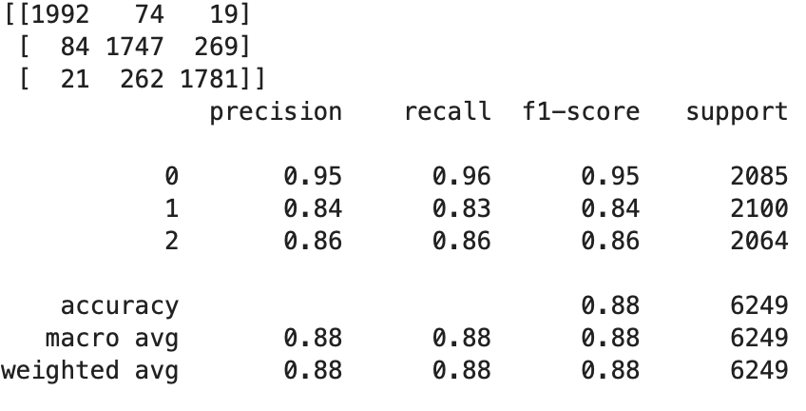
Methodology Results: Random Forest
Model Show accuracy of 88%
Precision is 84%
Recall is 83%
F1 score is 84%
Notes:
after building the model I visualize the performance of the Random Forest model using the Confusion matrix, this matrix compare the predicted values to the actual labels of the dataset.
Random forest model show the accuracy of 88%
Precision is 84% which measure - how accurate a model’s positive predictions are
Recall is 83% this measures the effectiveness of a classification model in identifying all relevant instances from a dataset.
F1 score is 84% this is used to evaluate the overall performance of a classification model

Slide 14
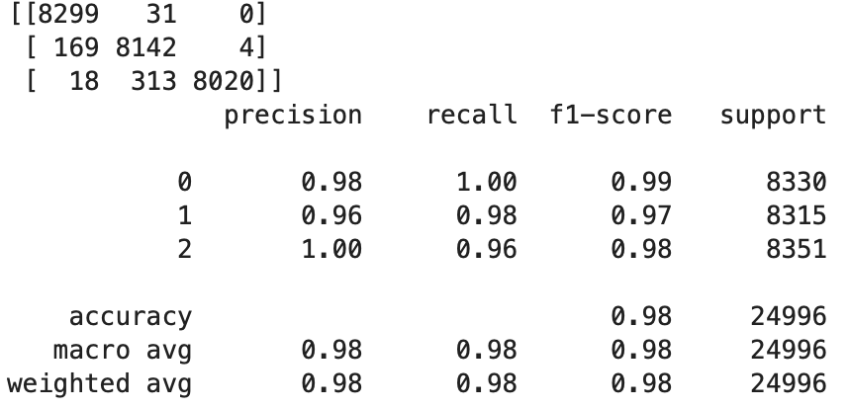
Methodology Results: Decision Tree
Model Show accuracy of 98%.
Precision is 96%
Recall is 98%
F1 score is 97%
Notes:
As next step I build the decision tree and evaluate the performance again using the confusion matrix and this model

Slide 15
Conclusion
Confusion Matrix and classification report show built model is working.
Results are encouraging.
Decision Tree show accuracy of 98% and came out as best model in this project scenario.
Further Research and Implementation
Notes:
The two-model decision tree and random forest were trained to performed prediction, but decision tree show the accuracy of 98% and came out as best model in this project scenario.
The model we build here using machine learning can help government in detecting severity in road accidents. Which in turns help them to introduce some rules and regulations which can reduce road accidents. Some preventative strategies can be implemented using the knowledge we gain from this analysis.
The next step is to partner with different government sector, share the importance of the machine learning model with them, get access and collect more data so the model can be tested more on real time data.
Once the testing is done, we can implement the model live where model can provide support to government by sharing important information about predictor variable that can be used to reduce the road accidents and its severity. Once the model has all the predictor variables, it can identify severity of the road accidents and can alert the government to make preventive strategies to safe people life or reduce risk. Regular checks can be done to make sure of the consistency of the model and flow of the data.

Slide 16
Sources:
World health Organization: - Road Traffic Injuries https://www.who.int/news-room/fact-sheets/detail/road-traffic-injuries
Data Source : - https://www.kaggle.com/datasets/kanuriviveknag/road-accidents-severity-dataset/data

